Slide 1



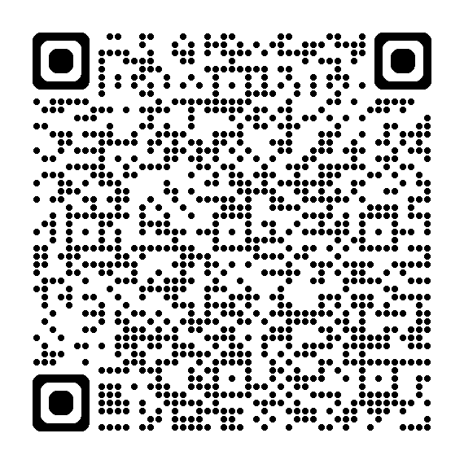
Internship - Occupational Safety Management Germany
Ingelheim I Job-ID: 33570
Requirements::
Enrolled in a technical degree program (e.g., Engineering, Occupational Safety, Environmental Science, or related fields)
German is a must
Proficient in Microsoft Excel and PowerPoint
Structured and detail-oriented working style
Interested in occupational safety and process optimization
More information:
https://bit.ly/4d37xc2
Not yours?
More jobs: https://lmy.de/UFtt

